Slide 1
SEQUENCES & SERIES Gr 12
PART 2
LEVEL 1&2 Questions

Slide 2
Finding the SUM of an AP
$$Sn = \frac{n}{2}[2a + \left(n – 1\right)d]$$
S_{n} = sum of n terms
a = first term
n = number of terms
d = common difference
Sum of an Arithmetic Sequence

Slide 3
Deriving the Sum formula of an AP
Write out the Sum of an AP, using the general term notation (i.e. T₁, T₂, T₃ … T_{n}) … call it Equation (1):
S_{n} = a + (a+d) + (a+2d) + … + [a+(n-2)d} + [a+(n-1)d] (1)
Rewrite the Sum of n terms of an AP, but in reverse … call it Equation 2:
S_{n} = [a+(n-1)d] + [a+(n-2)d} + … + (a+2d) + (a+d) + a (2)

Slide 4
Now add Equation 1 and Equation 2:
2 S_{n} = [2a+(n-1)d] + [2a+(n-1)d] + [2a+(n-1)d] + … +
[2a+(n-1)d] + [2a+(n-1)d]
So, if there are n terms, you have n times [2a+(n-1)d] terms:
2 S_{n} = n [2a+(n-1)d]
Solving for S_{n}:
$$Sn = \frac{n}{2} [2a+(n−1)d]$$
Proof of an Arithmetic Series

Slide 5
Alternative SUM formula of an AP
$$Sn = \frac{n}{2}[2a + \left(n – 1\right)d]$$
$= \frac{n}{2}\left[a+a+\left(n−1\right)d\right]$
$= \frac{n}{2}[a+\left\{a + \left(n – 1\right)d\right\}]$
$= \frac{n}{2}\left[a+T_{n}\right]$
$= \frac{n}{2}\left[a+l\right]$
S_{n} = sum of n terms
a = first term
n = number of terms
l = last term

Slide 6
Deriving the Sum formula of an AP
If they ask you to derive the formula, using the last term, where l = [a + (n-1)d]:
Write out the Sum of an AP, using the general term notation (i.e. T₁, T₂, T₃ … T_{n}) … call it Equation (1):
S_{n} = a + (a+d) + (a+2d) + … + (l – d) + l (1)
Rewrite the Sum of n terms of an AP, but in reverse … call it Equation 2:
S_{n} = l + (l – d) + … + (a+2d) + (a+d) + a …. (2)

Slide 7
Now add Equation 1 and Equation 2:
2 S_{n} = (a+l) + (a+l) + (a+l) + … + (a+l) + (a+l)
So, if there are n terms, you have n times (a+l) terms:
2 S_{n} = n(a+l)
Solving for S_{n}:
$$Sn = \frac{n}{2} (a+l)$$

Slide 8
Example 1:
Sibu’s parents put R100 into an account on the day that he was born and then decided to continue this every year but to increase the amount by R50 annually until he turns 21. How much will he receive on his 21st birthday.
100 , 150 , 200 …. S₂₁
i.e. a = 100; n = 21 and d = 50
$$Sn = \frac{n}{2}[2a + \left(n – 1\right)d]$$
$$S21 = \frac{21}{2}[2(100) + \left(21 – 1\right)(50)]$$
$=R12 600$

Slide 9
Example 2:
Determine the first term of an arithmetic progression if the sum of forty terms is 1660 and the last term is 77.
i.e. a = ?; n = 40; l = 77 and S₄₀ = 1660
$$Sn = \frac{n}{2}[a+l]$$
$$1660= \frac{40}{2}[a+77]$$
$$1660=20a+1540$$
$$20a =120$$
$a=60$

Slide 10
Sigma (Σ) Notation
e.g. $\sum_{i=1}^{n}{(4i−3)}$
Σ means the SUM of …
i is the start of the “counter”
n is the end of the “counter”
(4i – 3) is the general term
So, substitute i = 1 into the general term & calculate its value; then the counter clicks up one (i.e. 2); so substitute i = 2 and find the value of the term, all the way to the nth term. Now sum up all the terms.
Working with Sigma Notation

Slide 11
Example 1:
Calculate: $\sum_{i=3}^{23}{(8i+2)}$
Step 1: Find n
n = “top counter” – “bottom counter” + 1
= 23 – 3 + 1
= 21
Step 2: Find the first three terms, by substituting in the value of i
a = 8(3) + 2 = 26
T₂ = 8(4) + 2 = 34
T₃ = 8(5) + 2 = 42

Slide 12
Calculate: $\sum_{i=3}^{23}{(8i+2)}$
Step 3: Find d
[From Step 2: a = 26; T₂ = 34 and T₃ = 42]
d = 8
Step 4: Substitute into the sum formula
[From steps: n = 21; a = 26; d = 8]
$$Sn = \frac{n}{2}[2a + \left(n – 1\right)d]$$
$S21 = \frac{21}{2}[2(26) + \left(21 – 1\right)(8)]$
$=2226$

Slide 13
Example 2:
Determine the other possible value of n, given that $\sum_{r=1}^{2}{(4r−20)}=\sum_{r=1}^{n}{(4r−20)}$
$\sum_{r=1}^{2}{(4r−20)}$
a = 4(1) – 20 = -16
T₂ = 4(2) – 20 = -12
S₂ = -16 + (-12) = -28
$∴−28=\sum_{r=1}^{n}{(4r−20)}$

Slide 14
$−28= \sum_{r=1}^{n}{(4r−20)}$
n = ?
a = 4(1) – 20 = -16
T₂ = 4(2) – 20 = -12
T₃ = 4(3) – 20 = -8
d = -12 – (-16) = 4
S_{n} = -28
$$∴Substitute into the S_{n} formula$$
$$and solve for n$$

Slide 15
$$\left\{n=?; a=−16; d=4; S_{n}=−28\right\}$$
$$Sn = \frac{n}{2}\left[2a + \left(n – 1\right)d\right]$$
$$−28= \frac{n}{2}[2(−16) + \left(n – 1\right)(4)]$$
$$−56=n[−32+4n −4]$$
${4n}^{2} −36n+56$ = 0
$n^{2} −9n+14$ = 0
$$\left(n−7\right)\left(n−2\right)=0$$
$n=7 or n=2$ $∴Other value for n=7.$
Sigma Notation

Slide 16
THEORY:
$$T_{n}= S_{n}−S_{n−1}$$
EXAMPLE
Given: 5 ; 9 ; 13 ; 17 ; 21 ; 25 ; 29 ; 33
If $S_{n}=3n+2n^{2}$ , determine the 5th term

Slide 17
Solution
$$S_{5}=3\left(5\right)+2{\left(5\right)}^{2}$$
= 65
$$S_{4}=3\left(4\right)+2{\left(4\right)}^{2}$$
= 44
$$T_{n}=S_{n}−S_{n−1}$$
$$T_{5}=S_{5}−S_{4}$$
$$T_{5}=65−44$$
$$T_{5}=21$$

Slide 18
SUM OF
GEOMETRIC SEQUENCES

Slide 19
Finding the SUM of a GP
$Sn = \frac{a(r^{n}−1)}{r−1} (r>1 ; r ≠1)$
S_{n} = sum of n terms
a = first term
n = number of terms
r = common ratio

Slide 20
Deriving the Sum formula of a GP
Write out the Sum of a GP, using the general term notation (i.e. T₁, T₂, T₃ … T_{n}) … call it Equation (1):
$Sn = a +ar+ar^{2} + … + ar^{n−2}+ar^{n−1}$ (1)
Now multiply both sides of Equation 1 by r … call it Equation 2:
$rSn = ar +ar^{2}+ar^{3} + … + ar^{n−1}+ar^{n}$ (2)

Slide 21
Now subtract Equation 1 from Equation 2:
$Sn = a +ar+ar^{2} + … + ar^{n−2}+ar^{n−1}$ (1)
$rSn = ar +ar^{2}+ar^{3} + … + ar^{n−1}+ar^{n}$ (2)
$$rS_{n} − S_{n}=−a+0+0+ …+0+ ar^{n}$$
Simplify and take out a common factor:
$$rS_{n} − S_{n}=ar^{n} −a$$
$$S_{n} \left(r−1\right)=a(r^{n} −1)$$
Solving for S_{n}:
$$S_{n} = \frac{a(r^{n}−1)}{r−1} (r≠1)$$
Proof of a Geometric Series
Sum of a Geometric Sequence

Slide 22
Example 1:
Determine the sum of the first ten terms, given the geometric sequence: -4; 8; -16; …
i.e. a = -4; n = 10; r = -2 and $S_{10}=?$
$$S_{n} = \frac{a(r^{n}−1)}{r−1}$$
$S_{10} = \frac{\left(−4\right)[({−2)}^{10}−1)}{(−2)−1}$
$=1364$
Working with Geometric Progressions

Slide 23
Example 2:
Determine x and then the sum of the first twelve terms, given: 1$; \frac{x}{8}; \frac{1}{x};…$
$\frac{x}{8}÷1=\frac{1}{x} ÷\frac{x}{8}$
$\frac{x}{8}= \frac{8}{x^{2}}$
$x^{3}=64$
$x=4$
$$∴Sequence: 1; \frac{1}{2}; \frac{1}{4}; …$$
$$S_{n} = \frac{a(r^{n}−1)}{r−1}$$
$S_{10} = \frac{\left(−4\right)[({−2)}^{10}−1)}{(−2)−1}$
$=1364$
$$r= \frac{T_{2}}{T_{1}}=\frac{T_{3}}{T_{2}}$$

Slide 24
$$∴Sequence: 1; \frac{1}{2}; \frac{1}{4}; …$$
i.e. a = 1; n = 12; r = ½ and $S_{12}=?$
$$S_{n} = \frac{a(r^{n}−1)}{r−1}$$
$S_{12} = \frac{\left(1\right)[\left({\frac{1}{2})}^{12}−1\right)]}{(\frac{1}{2})−1}$
$=1,999..$
$≈2$

Slide 25
Example 3:
Calculate: $\sum_{k=1}^{13}{ 6{(−3)}^{k−1}}$
n = 13 – 1 + 1
= 13
a = $6{(−3)}^{1−1} =6$
T₂ = $6{(−3)}^{2−1} =−18$
T₃ = $6{(−3)}^{3−1} =54$
$r=−\frac{18}{6}=−$3

Slide 26
i.e. a = 6; n = 13; $r=−3$ and $S_{13}=?$
$$S_{n} = \frac{a(r^{n}−1)}{r−1}$$
$S_{13} = \frac{\left(6\right)[\left({−3)}^{13}−1\right)]}{(−3)−1}$
$=2 391 486$

Slide 27
Characteristics of the SUM TO INFINITY
In an Arithmetic Progression, the sum to infinity will result in a DIVERGING series
i.e. the sum will be infinitely big or infinitely small
In a Geometric Progression, the sum to infinity will result in a CONVERGING series
i.e. the sum will be get closer and closer (converge) to a particular number

Slide 28
Requirements to find the SUM TO INFINITY
Must be a Geometric Progression
(as the series will converge)
The common ratio must be between -1 and 1
i.e. $−1 < r <1$
Sum to Infinity

Slide 29
Finding the SUM TO INFINITY
$S_{∞}= \frac{a}{1−r} (−1<r <1)$
$S_{∞}$ = sum to infinity
a = first term
r = common ratio
Sum to infinity example

Slide 30
Example 1:
Determine the sum to infinity of: 1 + ½ + ¼ + …
i.e. a = 1; n = ∞; r = ½ and $S_{∞}=?$
$$S_{∞}= \frac{a}{1−r}$$
$= \frac{1}{1−(\frac{1}{2})}$
$=2$

Slide 31
Example 2:
For which values of x will this sequence converge?
$$(2 − x) + ( 2 − x)2 + ( 2 – x)3 + ….$$
For a converging sequence: $−1 <r< 1$
In this sequence: $r=2−x$
$$∴ −1 <2 −x< 1$$
$−3 <−x<−1$
$1 <x<3$

Slide 40
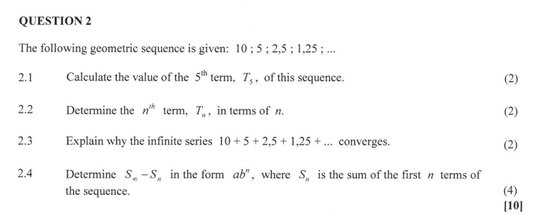

Slide 44
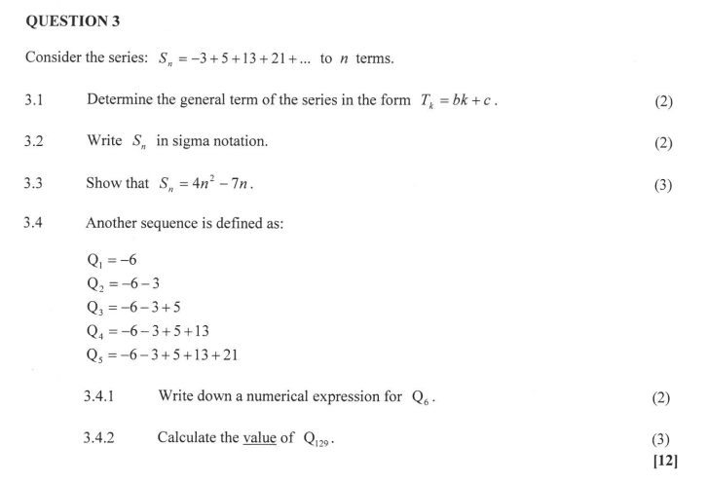

Slide 48
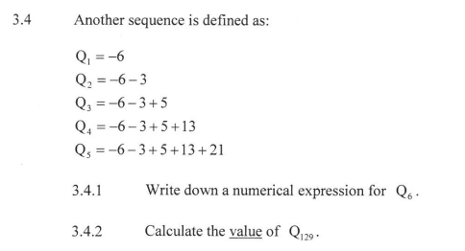

Slide 49
THE END

